Slide 1
Lab 3: Your first hack Ryan Coon Cyb-610 professor ian Standefer April 2, 2025

Slide 2
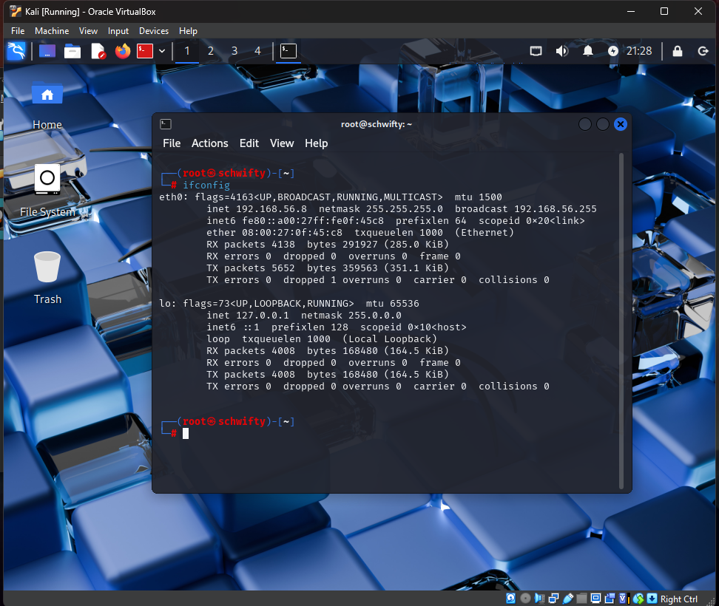
Ifconfig Command
Turned on both the Kali Linux VM
And Kioptrix 1 VM. Ran the ifconfig
Command on the Kali box. We can see
that the Nat network is working
Correctly as we have an ip address of
192.168.56.8.

Slide 3
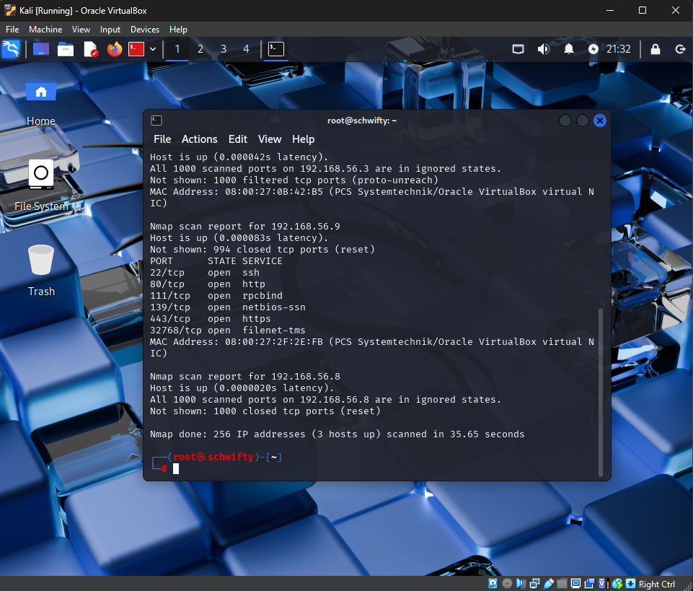
Nmap Scan
After verifying that we are on host
Only network, we can now run an
Nmap scan. We run the nmap
Command with the range of
192.168.56.0/24 so that only the
Last octet is set to scan. This is a
Basic ping sweep.

Slide 4
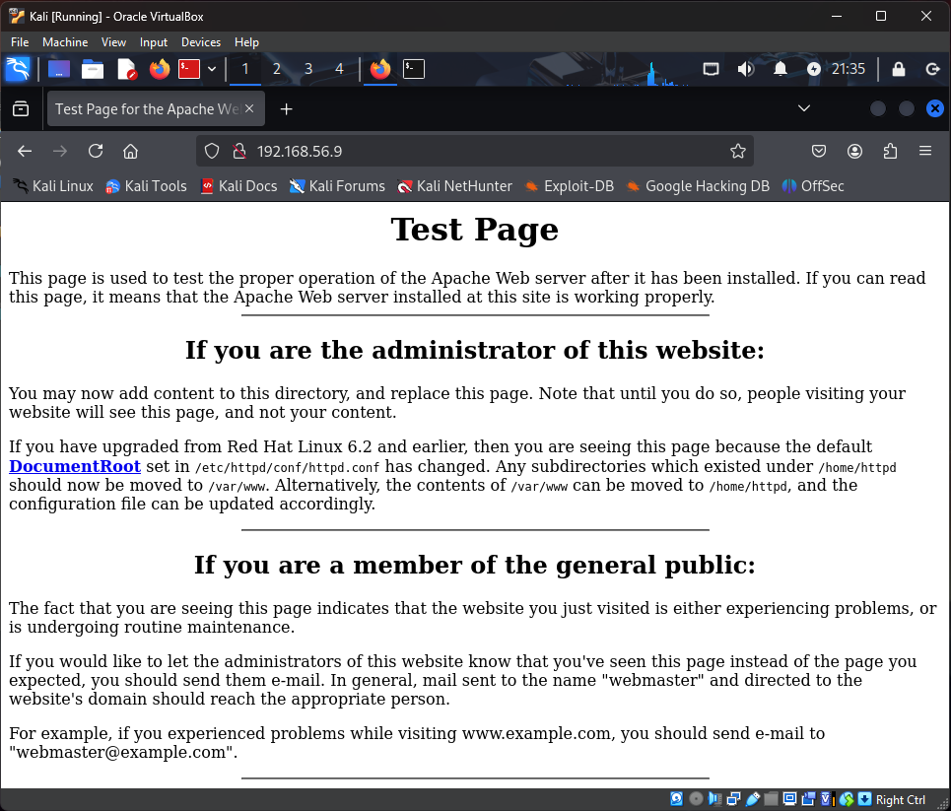
Ping to test page
After running the nmap scan, we
Can see that the Kioptrix 1 ip address
Is 192.168.56.9. We then opened Firefox,
Entered the ip address and hit enter. This
Way pings the ip address and the outcome
Shows in the way of the test page.

Slide 5
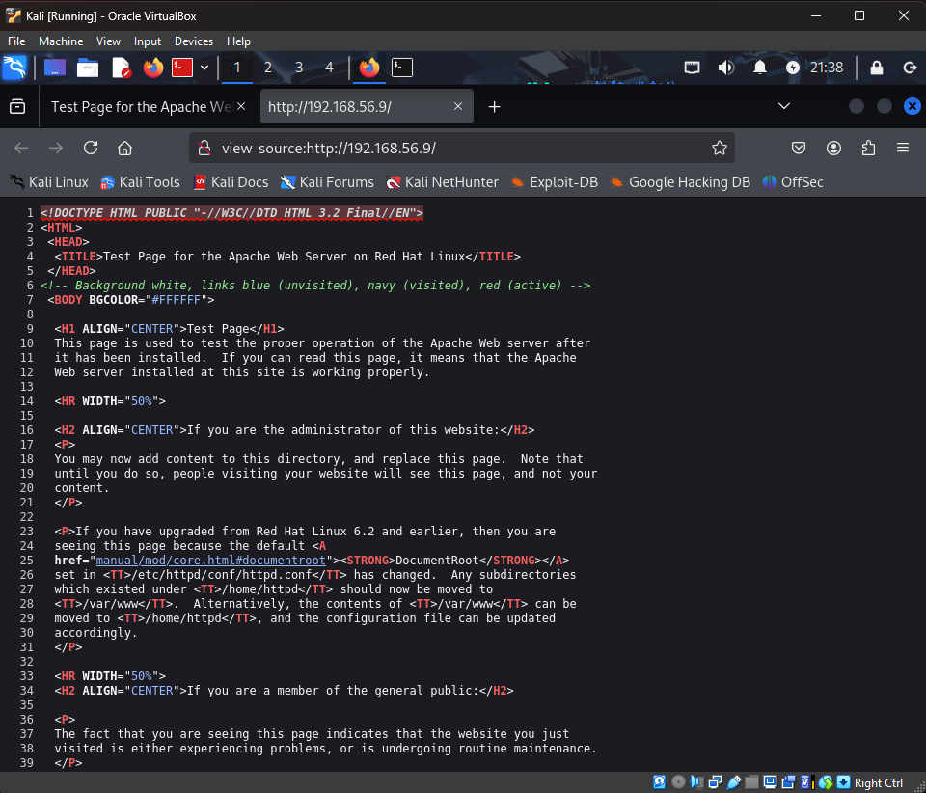
Page Source Code
If you right click on the webpage
And select “View page source”,
You will then see all of the source
Code and comments that the developers
Used.

Slide 6
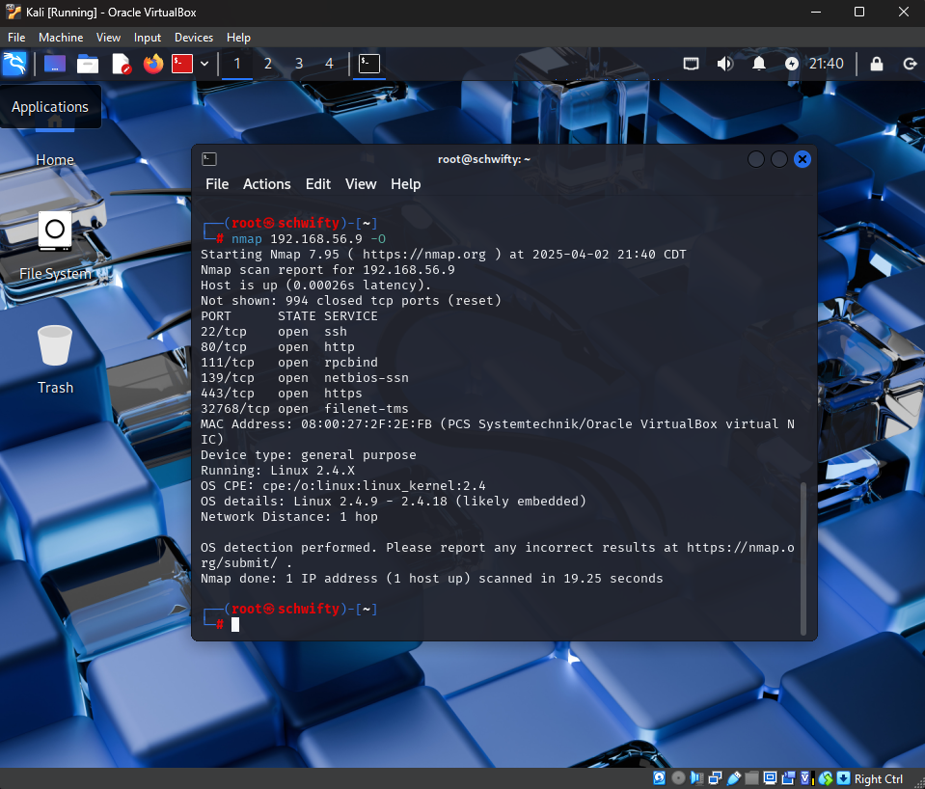
Nmap –O Command
After verifying the Kioptrix 1 vm was
Discoverable using an nmap ping,
We then run another nmap command.
We will run nmap –O against the Kioptrix 1
Ip address. The nmap –O command is
Used to scan and identify the targets OS.
We can see that Kioptrix is running on a
Linux 2.4.9 OS.

Slide 7
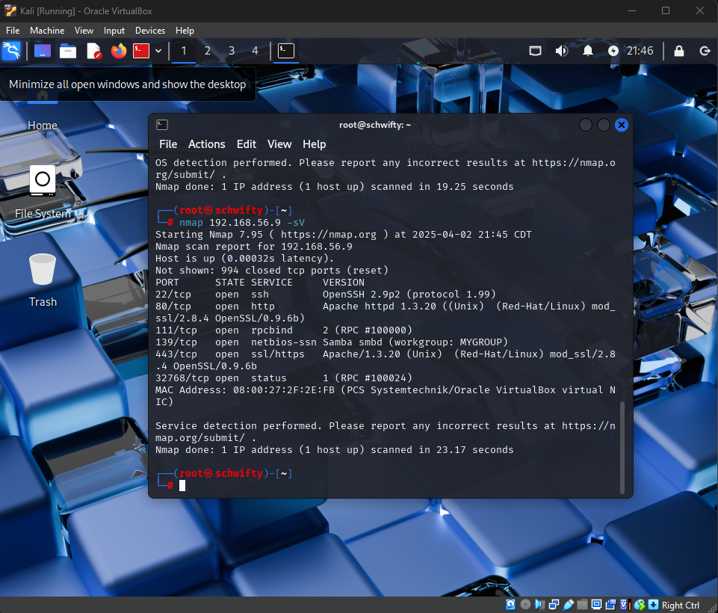
Nmap –sV Command
We will then run the command nmap
-sV. This command addition is dedicated
Services. With this command we can use it
To find versions, ports, and more details
About the system.

Slide 8
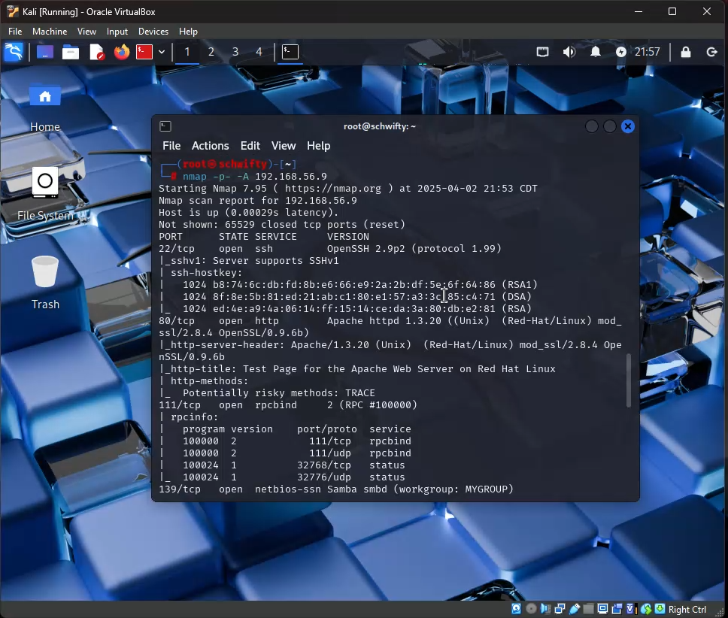
Nmap –p- -A Command
Next we will run an intrusive scan.
To do this we will use the command
Nmap –p- -A 192.168.56.9. This will
Provide information on all open ports
That can be possible vulnerabilities.
This is a full network scan to see all
Devices on the network.

Slide 9
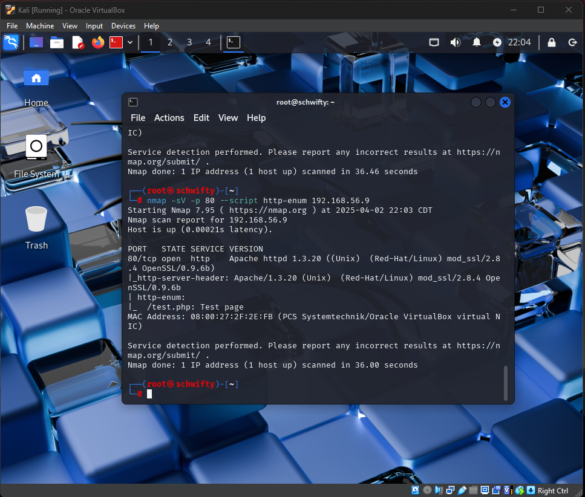
Nmap Command 1
Nmap –sV –p 80 –script http-enum
This scan is an intrusion scan of the port
80 which is an http port associated with
the web. It is used to find vulnerabilities
and other anomalies associated with
that specific port.

Slide 10
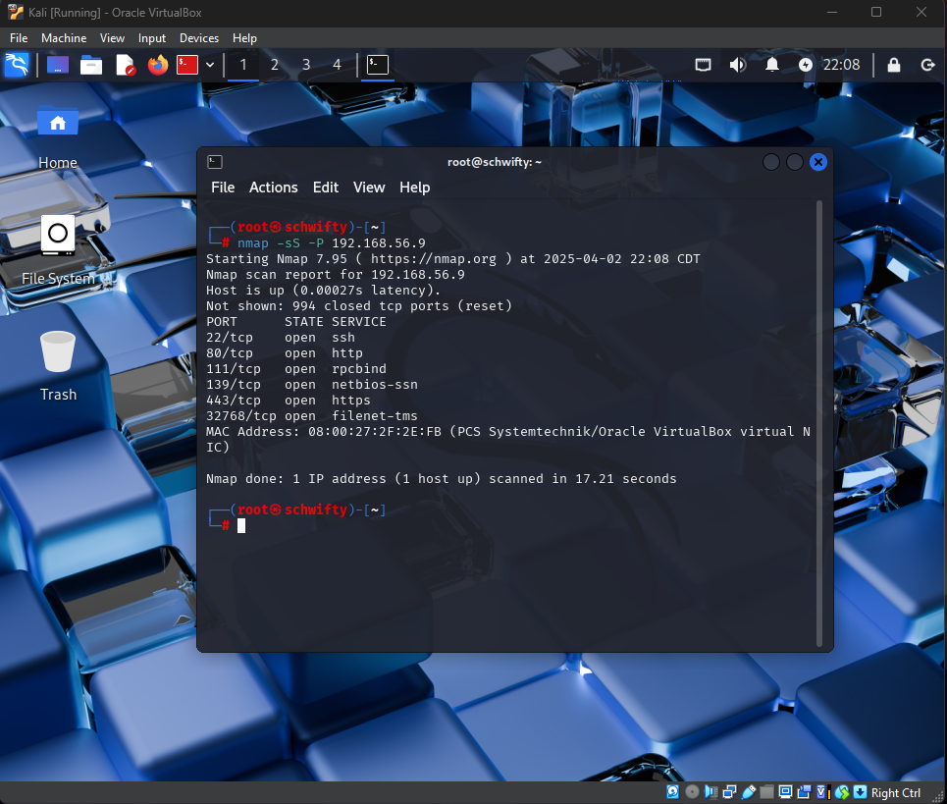
Nmap Command 2
Nmap –sS –p 192.168.56.9
This scan is an anti-detection scan
against things like firewalls and IDS.
It allows the user to communicate with
a system without fully completing the
3-part handshake.

Slide 11
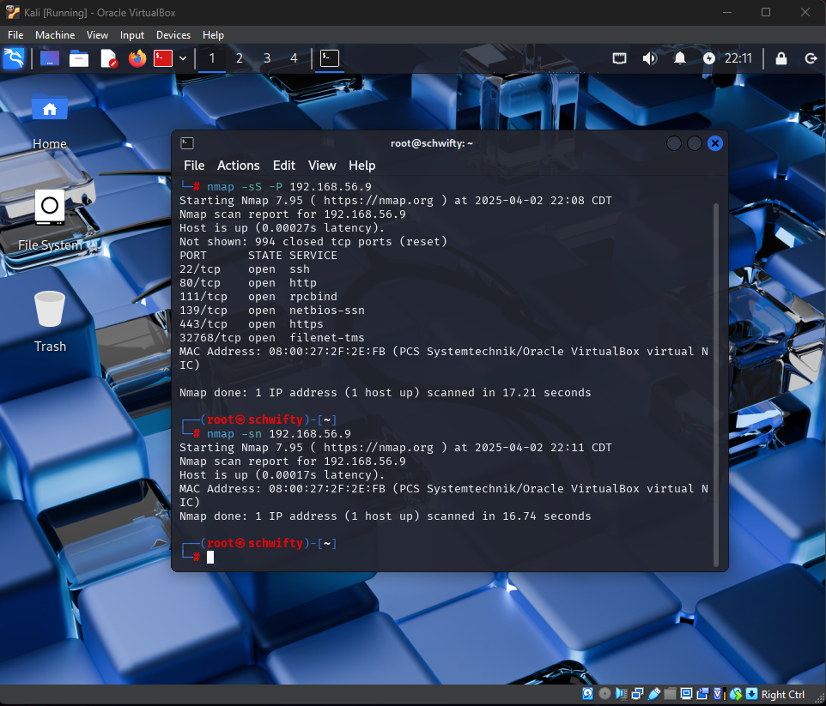
Nmap Command 3
Nmap –sn 192.168.56.9
This is a no port scan that is used
to scan the devices on a network.
While it may not seem as useful as
a port scan the implications of
knowing every device on a network
including things like security systems
or ring doorbells is very intrusive.

Slide 12
Flaw Hypothesis Methodology
The flaw hypothesis approach, a systems analysis and penetration prediction technique,
begins by identifying potential software vulnerabilities through a review of system requirements
and documentation. This list of potential weaknesses is then prioritized based on their likelihood
and the ease with which they could be exploited to gain unauthorized access or compromise data.
This prioritized list subsequently guides the actual system testing.
My analysis suggests that this system likely has multiple vulnerabilities, with the most easily
exploitable being ports 22 and 139. These ports, commonly used for Secure Shell (SSH) and
Server Message Block (SMB) protocols respectively, may present significant security risks.

Slide 13
Flaw 1 - Samba
Vulnerabilities in Samba version 2.2.1a can be exploited using at least two methods.
One method leverages Metasploit to gain root access; another uses a Perl script to
trigger a heap-based buffer overflow via a crafted Samba request with numerous security
descriptors. This second method can cause a denial-of-service (application crash) and
potentially allow arbitrary code execution.

Slide 14
Flaw 2 – Open SSH
Exploiting OpenSSH
Research on OpenSSH 2.9p2 revealed a critical vulnerability stemming from an "off-by-one"
error within its channel code. This flaw allows malicious actors to potentially gain elevated
privileges on the system. Additionally, this vulnerability can lead to information disclosure,
enabling a remote attacker to enumerate all user accounts on the system.

